Slide 1


Welcome to Admitted Student Day!
February 2, 2018

Slide 2
Quantifying Thrill

Slide 3
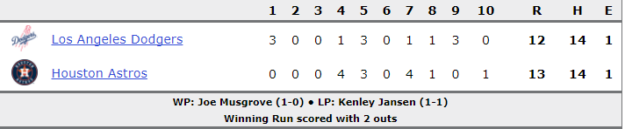
2017 World Series: Game 5
Best-of-seven series tied, 2-2

Slide 4
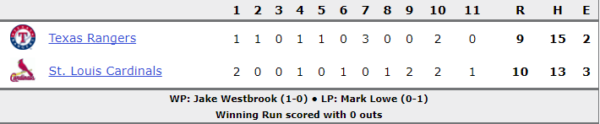
2011 World Series: Game 6
Texas leading series, 3-2

Slide 5
Which game was more exciting?

Slide 6
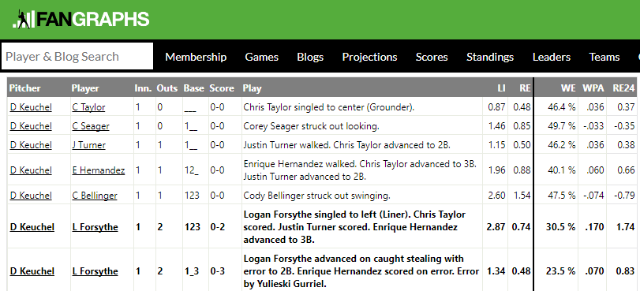
Win Probability Added (WPA)
Houston’s Win Expectancy following event

Slide 7
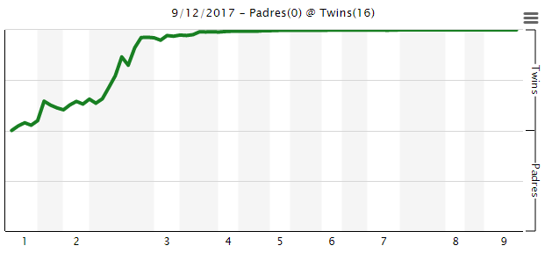
By graphing win expectancy over course of game, we get an idea of how “exciting” a game is.
A typical, “boring” game (9/12/17, Twins beat Padres 16-0):

Slide 8

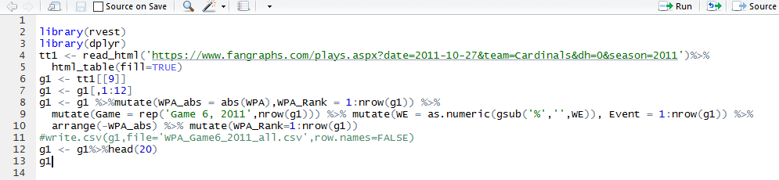
Comparing World Series games
Step 1: Scrape data from both games from Fangraphs

Slide 9
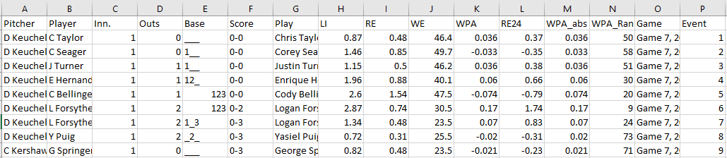
Comparing World Series games
Step 2: Write to “nice” format (e.g., Excel)

Slide 10
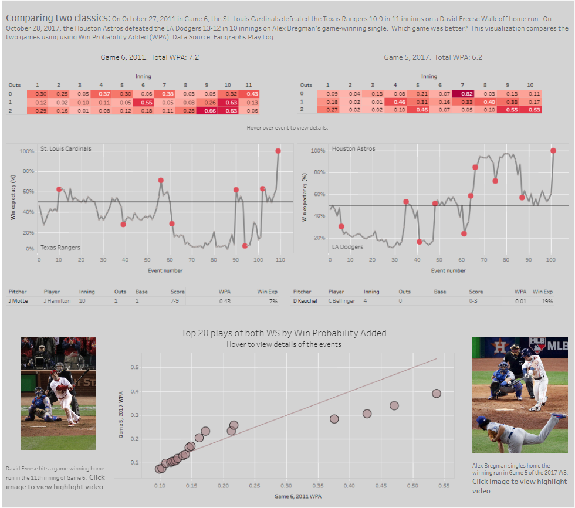

Comparing World Series games
Step 3: Visualize!

Slide 11
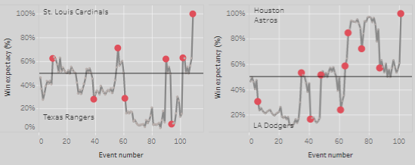
Game 6, 2011:
Game 5, 2017:
= “Exciting Event” (WPA > 15%)

Slide 12
Game 6, 2011
8 “exciting events”
Total WPA: 7.2
Game 5, 2017
10 “exciting events”
Total WPA: 6.2
= “Exciting Event” (WPA > 15%)

Slide 13
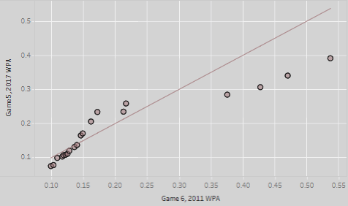
WPA of top-20 “most exciting plays” from each game
Game 5, 2017
Top 4 “most exciting” plays in 2011 were more exciting than top 4 “most exciting plays” in 2017
Game 6, 2011

Slide 14
Quantifying Student Satisfaction
(or lack thereof)

Slide 15
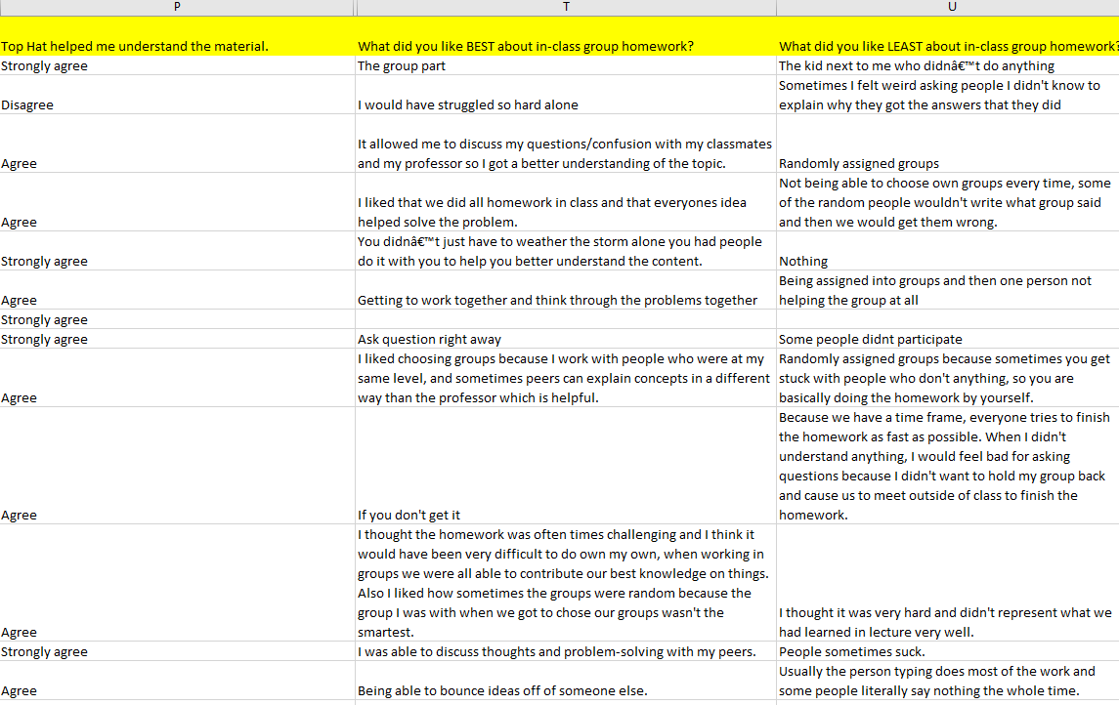

Slide 16
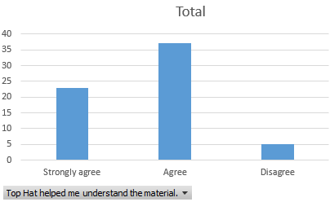

Slide 17
??
??

Slide 18
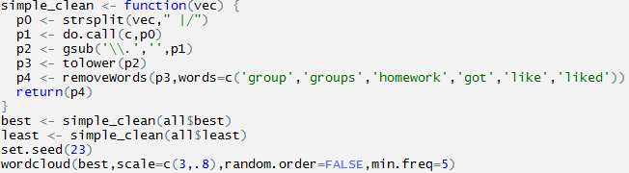

Slide 19
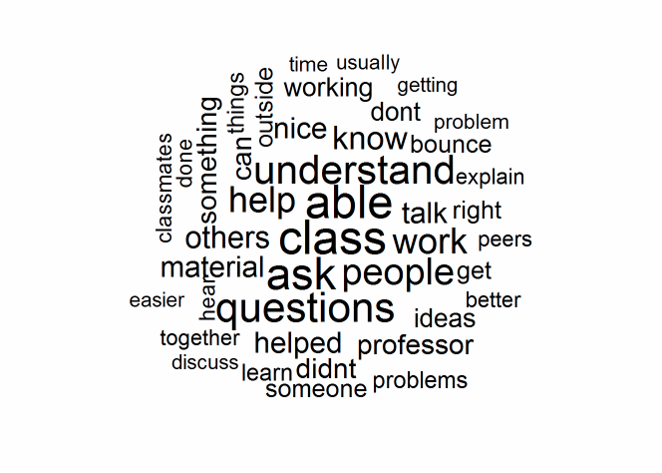
What did you like BEST about in-class group homework?

Slide 20
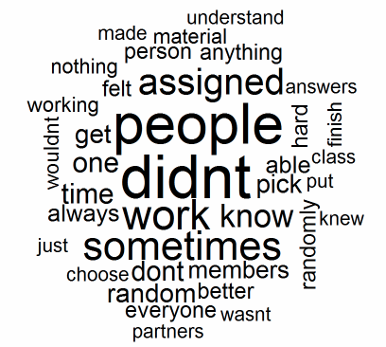
What did you like LEAST about in-class group homework?

Slide 21
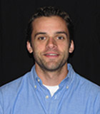
More specifics on our department…
…With this cool dude

Slide 22








































Our Alumni Where are they employed?

Slide 23


Scholarships in Math, MathEd, Stats & DSCI
Camille Gilbertson Moll Award $4000 Math, Stat, DSCI, Science
Walter Wadewitz Award $2400 MathEd majors
Lorena Jacobson Award $3000 Math, Stat, MathEd Majors
May S Murray Award $1000 Math, MathEd Majors
Judy & Spencer Munkel Award $2000 Math, MathEd, Stat Majors
Gardiner Award Math/Stat $1000 Math, Stat, DSCI Majors
Gardiner Award MathEd $1000 MathEd Majors
Fred & Sandy Olson Award $1000 Math, Stat, MathEd,
Duane & Edina Wolfe Award $1000 MathEd Majors
Bachler Memorial Award $800 MathEd Majors
Math/Stat Alumni Award $600 Math, Stat, MathEd, DSCI
Daniel Rand Award $500 Stat and DSCI Majors
Benchmark Award $450 Incoming Stat Major

Slide 24
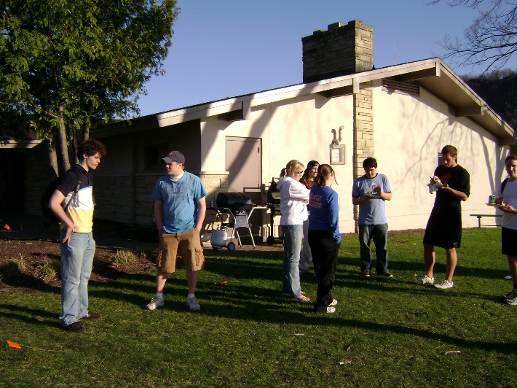
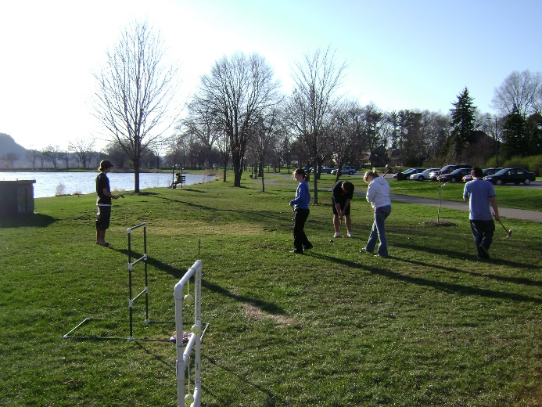
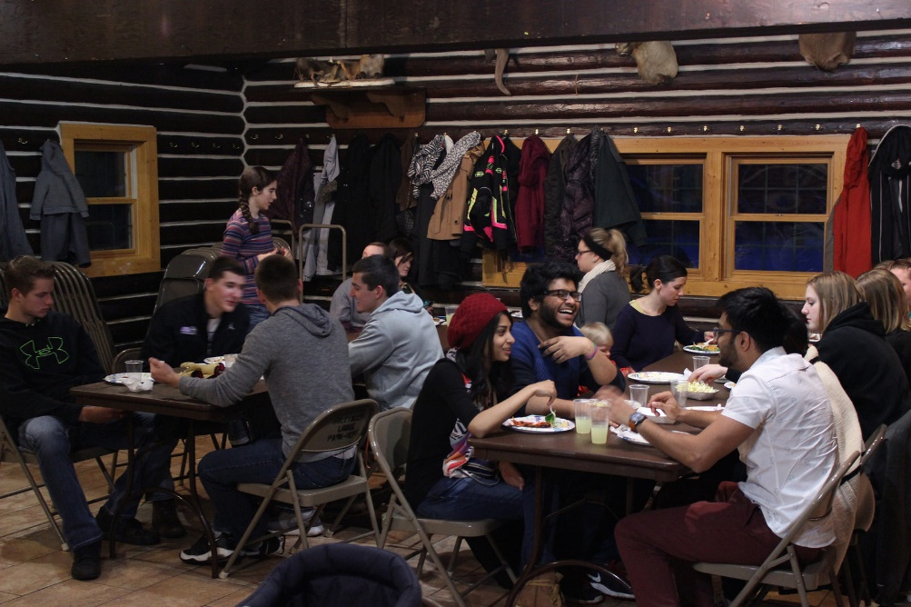
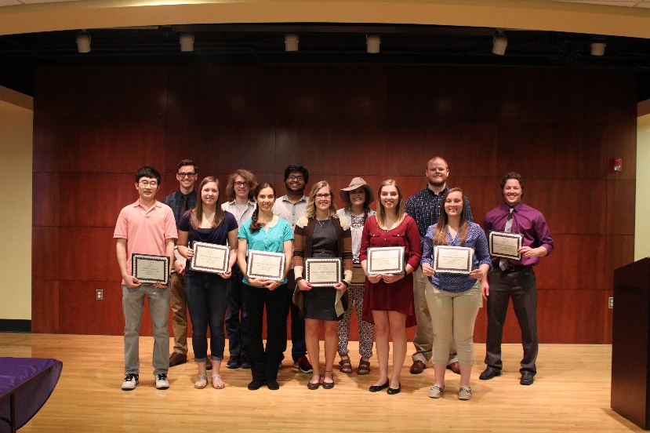
Social Events – Spaghetti Dinner
Spring Math/Stats Picnic
Spring Math/Stats Pinic
Spring Award Ceremony

Slide 25

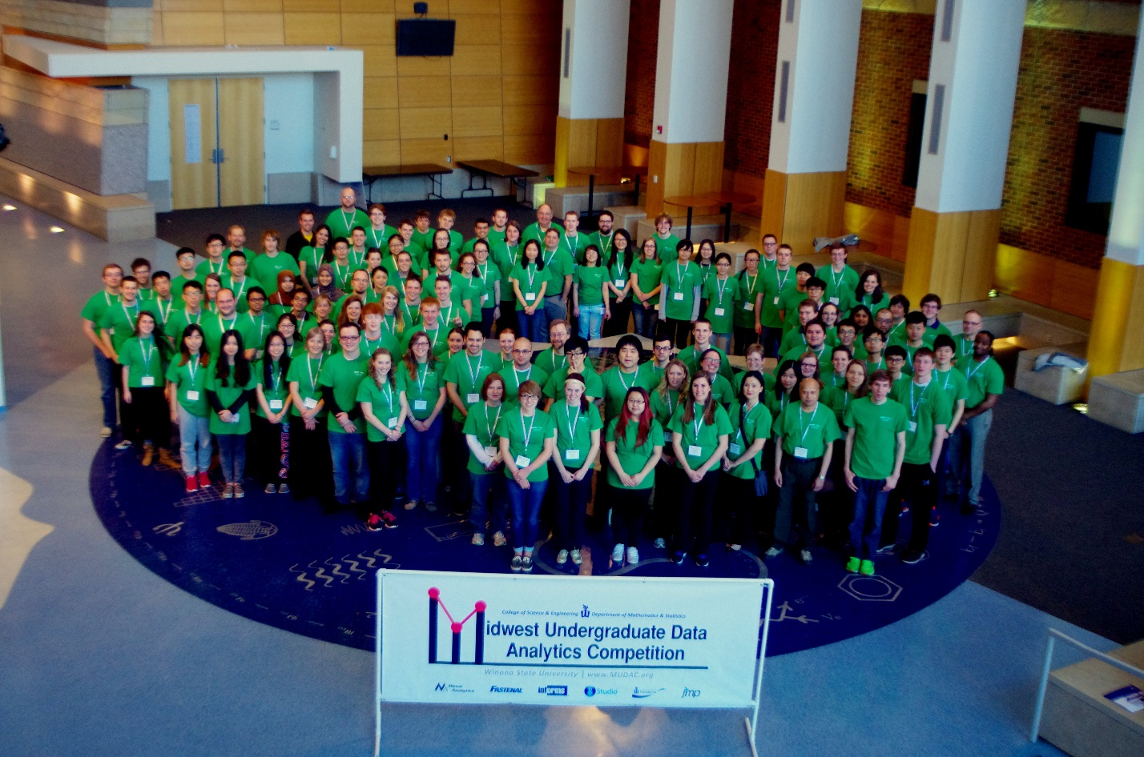

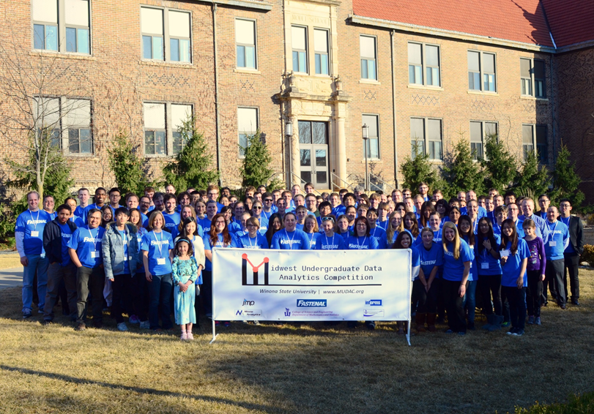

Slide 26


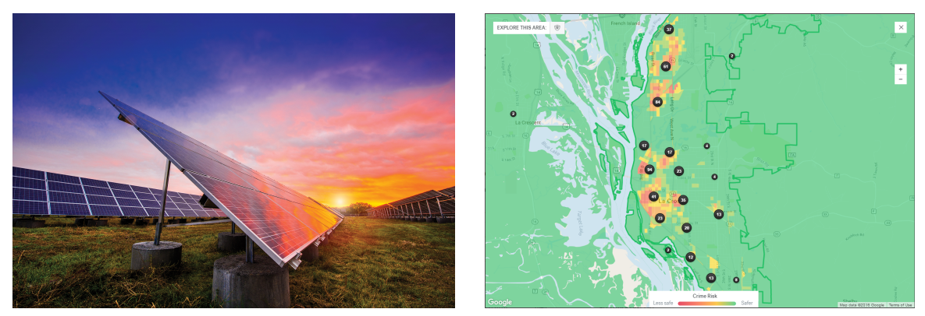
Math Competition Participation
North Central Section Team Competition
Wisconsin Mathematical
Modeling Challenge

Slide 27


Math/Stats Student Teaching Supervision
Student Teaching Seminars
Support with MTLE Exams
Support with edTPA
Practice Job Interviews
Partnerships with the Local School Districts
Public Service Loan Forgiveness

Slide 28
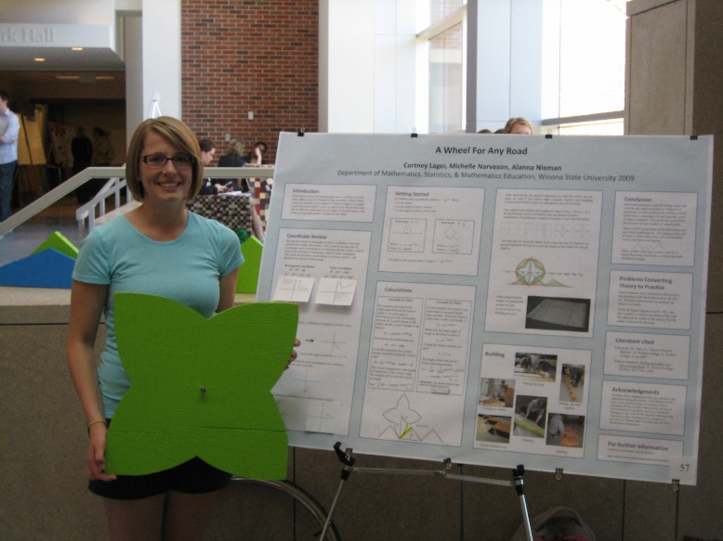
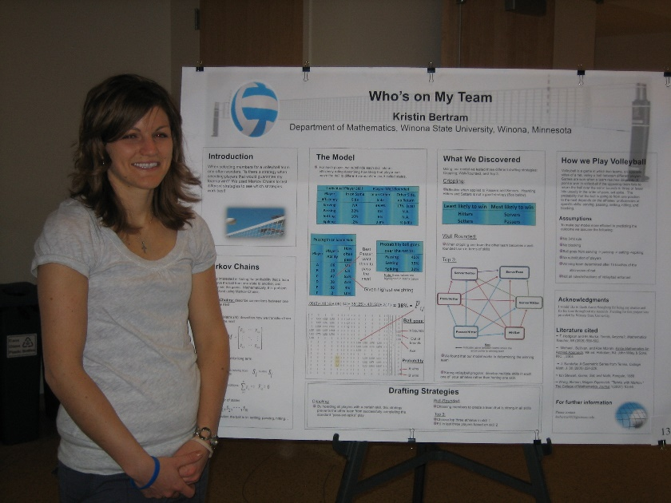
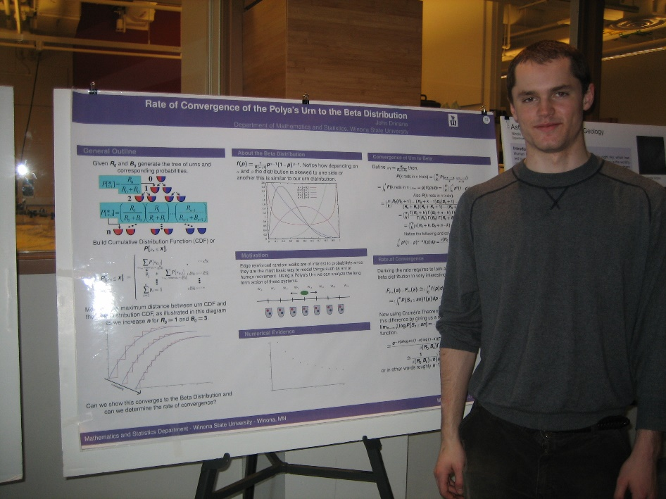
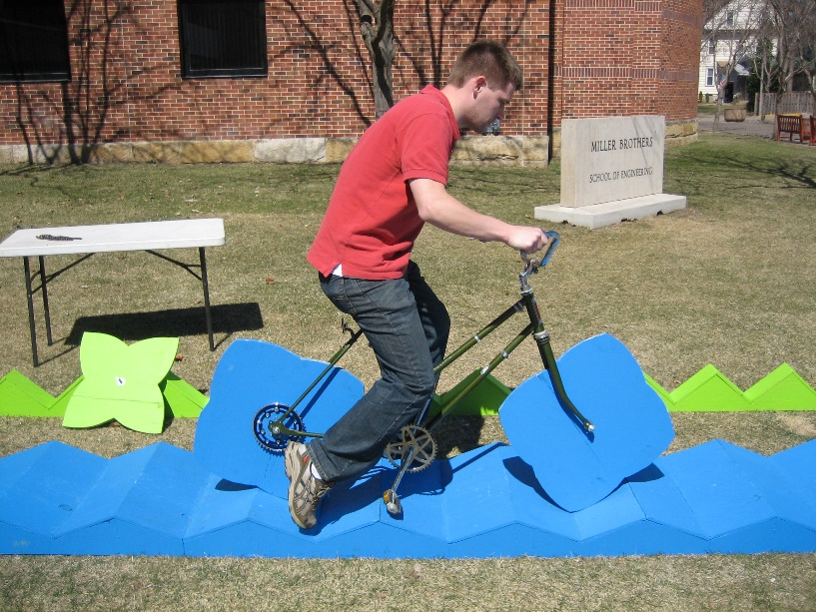
Undergraduate Research

Slide 29
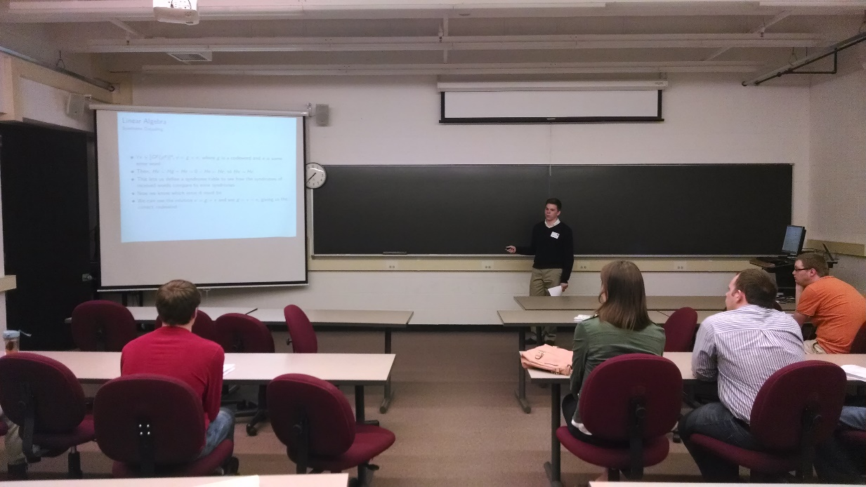

Student Travel Support For Conferences
PME Conference – Fall and Spring
MAA Math Fest – Washington DC, Seattle, Chicago …
National Council of Teachers of Mathematics – Regional Conferences
Minnesota Council of Teachers of Mathematics – Duluth

Slide 30



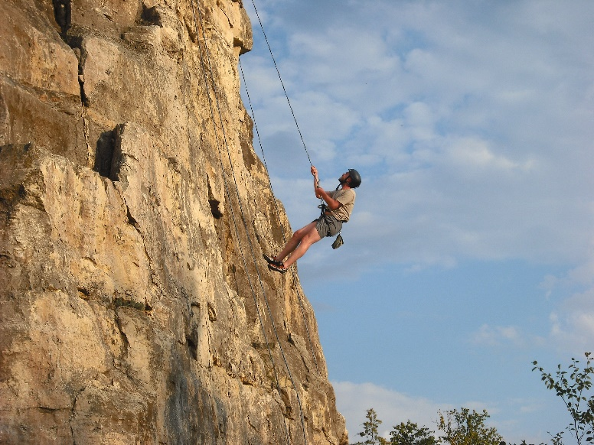
Winona Outdoor Recreation

Slide 31

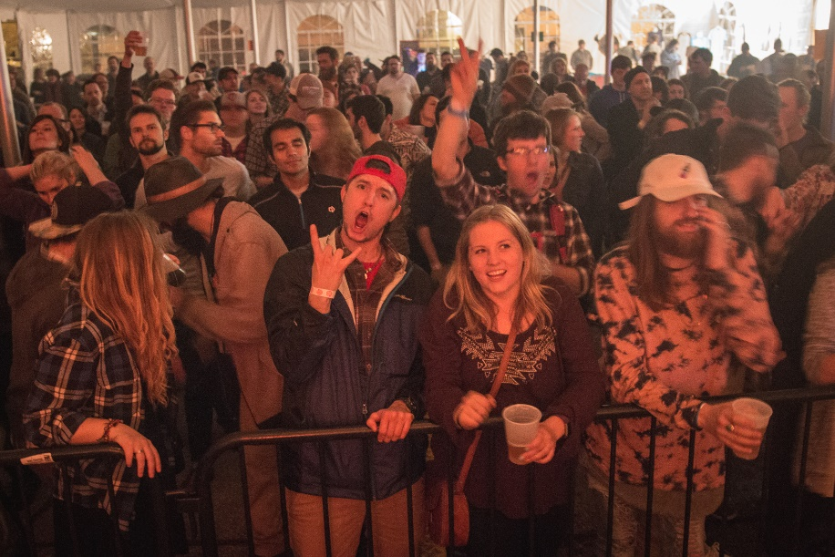



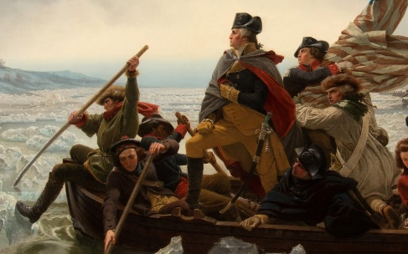
Winona Arts and Cultural

Slide 32

We Hope to See You in the Fall!

